Slide 2
Welcome to US History Talks

Slide 3
Preview : Module 6: A Nation Adrift
Talk | Title | Time Period | Date of Talk
37 | The Great Society | 1964-1968 | May 19th
38 | Vietnam | 1961-1975 | June 2nd
39 | US society and culture 1960’s | 1960-1970 | June 16th
40 | Return of the Republicans | 1968-1976 | September 1st
41 | Cold War during the 1970’s | 1969-1980 | September 15th
42 | The “Humility Experiment” | 1976-1980 | September 29th
43 | US society and culture 1980 | 1970-1980 | October 6th

Slide 4
Talk 39: 1960’s US Culture & Society
Social change by the numbers
Clothes, cars, and music
Intermission
The Counter Culture(s)
The Counter, counter cultures

Slide 5
Social Change by the numbers

Slide 6
People 1960-1970
Growing population, still homogenous, low immigration
 | 1960 | 1970
Population | 179m | 203m
% White | 89% | 88%
% Black | 11% | 11%
Internal Migration to Sunbelt:
 | 1960 | 1970 | %
California | 16m | 20m | +27%
Florida | 5m | 7m | +37%
Texas | 9m | 11m | +17%
New York | 34m | 36m | +9%
Low level of immigration (3m) foreign born 5% population (vs 14% 1900, 14% 2020)

Slide 7
Economics
House hold income rose from $49,000 to $60,000 (2020 dollars) + 22%
Growth in manufacturing jobs/High levels of unionized jobs
Increase in dual- income households women working 38% to 43%
Expansion of Medicare (for retired) Medicaid (for low incomes)
Low unemployment 6% 1960 5% 1970
Gap narrows between black and white (black income up from 55% to 61% white
Increase in services, reduction in farm work
 | 1960 | 1970
Manufacturing | 29% | 27%
Services | 39% | 43%
Agricultural | 8% | 6%

Slide 8
USA still the world economic superpower ………..….Europeans (except UK) catching up ………….Japan rising from the ashes
GDP of top 6 Nations
 | 1960m | 1970m | Growth
USA | 520 | 1,075 | 107%
USSR | 142 | 433 | 205%
West Germany | 92 | 208 | 126%
United Kingdom | 72 | 125 | 74%
France | 62 | 146 | 135%
Japan | 44 | 209 | 375%
US dominance declining…..share of world GDP falls from 40% to 26%
…...share of world trade falls from 15% to 9%, …..oil production from 40% to 24%

Slide 9
Emergence of the “Baby boomers”
Significant increase in younger generation
 | US population | Aged 18-30 | % Total
1940 | 132 m | 20m | 15%
1970 | 205m | 43m | 21%
2024 | 335m | 55m | 16%
First generation predominantly middle class…rising wages, secure work, no
Middle Class Population
1900 | 30%
1940 | 40%
1960 | 60%
1970 | 65%
Plenty of housing and at only 2 x earnings with new 30 year fixed rates mortgage
First generation subject to “new” thinking regarding child care

Slide 10
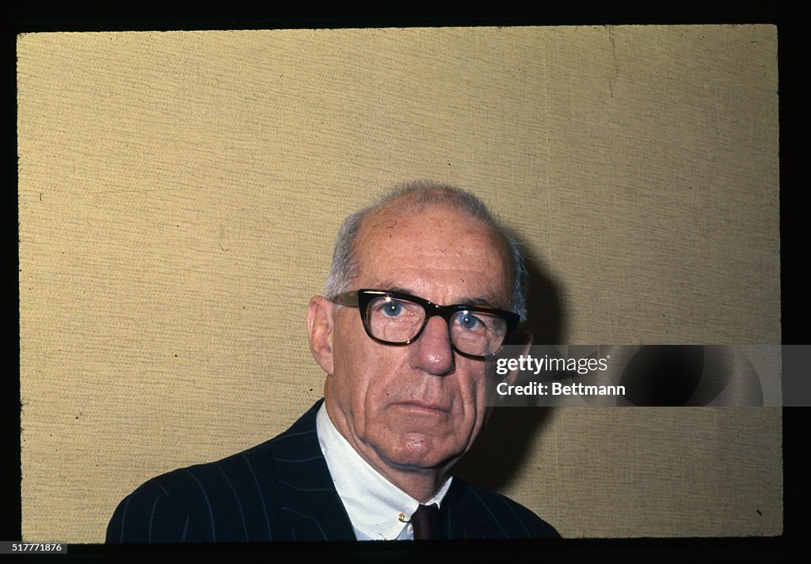
Doctor Benjamin Spock (1903-1998)
“The Book”
…50 million sold
Childcare prior to 1950’s
….discipline
….fixed feeding schedule
… maintain distance
…encourage independence
Dr Spock 1968
Dr Spock
….encourage love/ affection
…. Each child an individual
….follow instincts
Becomes ardent Socialist
…anti war activist
….Vegan

Slide 11
Doctor Spock quotes
The main source of good discipline is growing up in a loving family, being loved and learning to love in return.
The children who are appreciated for what they are, even if they are homely, or
clumsy, or slow, will grow up with confidence in themselves and happy. They will
have a spirit that will make the best of all the capacities that they do have and of all
the opportunities that come their way.
Humans can be the most affectionate and altruistic of creatures, yet they're potentially
more vicious than any other. They are the only ones who can be persuaded to hate millions of
their own kind whom they have never seen and to kill as many as they can lay their hands on in the
name of their tribe or their God.

Slide 12
A time of major changes in behaviour
Reduction in family stability
 | 1960 | 1970 | 2024
Fatherless households (all) | 8% | 11% | 20%
Fatherless households (black) | 22% | 32% | 55%
Divorce rate per 1000 women | 9% | 15% | 14%
Unmarried mothers | 5% | 11% | 40%
Fewer Children/ better educated
 | 1960 | 1970 | 2024
Births per women | 3.7 | 2.5 | 1.9
College graduates | 41% | 55% | 91%
More violent…..….,more high…more sexually active
 | 1960 | 1970 | 2024
Homicide rate/1000 | 4.6 | 7.9 | 4.5
Occasional marijuana use | 1% | 10% | 20%
Acceptance premarital sex (women) | 10% | 65% | 66%

Slide 13
………..and Changing beliefs/ attitudes
 | 1960 | 1970 | 2024
Tried Marijuana | 1% | 10% (40% teenagers) | 19% (35% teenagers)
Interracial marriage okay | 4% | 30% | 95%
Believe in God | 98% | 94% | 74%
Christian | 90% | 89% | 63%
Ok to live next to blacks | >50% | 73% | 90%
Trust government to do what is best for me | 80% | 50% | 24%
USA 1960’s a “Different place”…more affluent, educated, informal chaotic and violent ….clothes, cars, and music

Slide 14
Cars, houses, looks and music

Slide 15
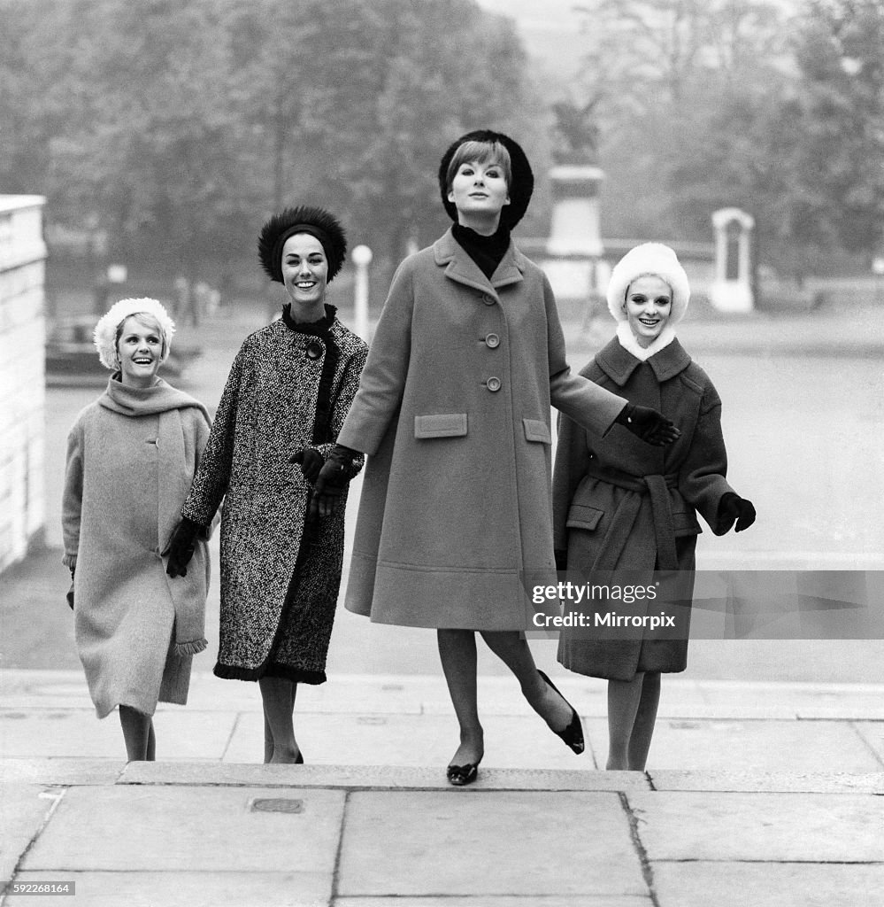
New York Ladies 1961

Slide 16
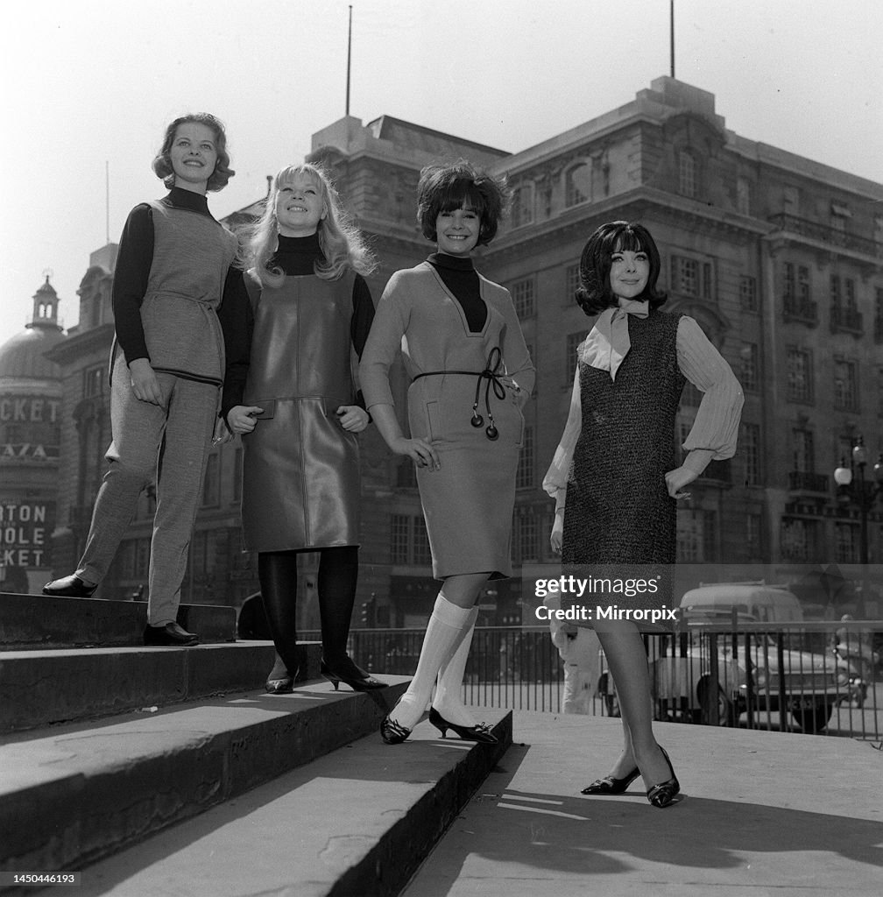
Teenagers 1961

Slide 17
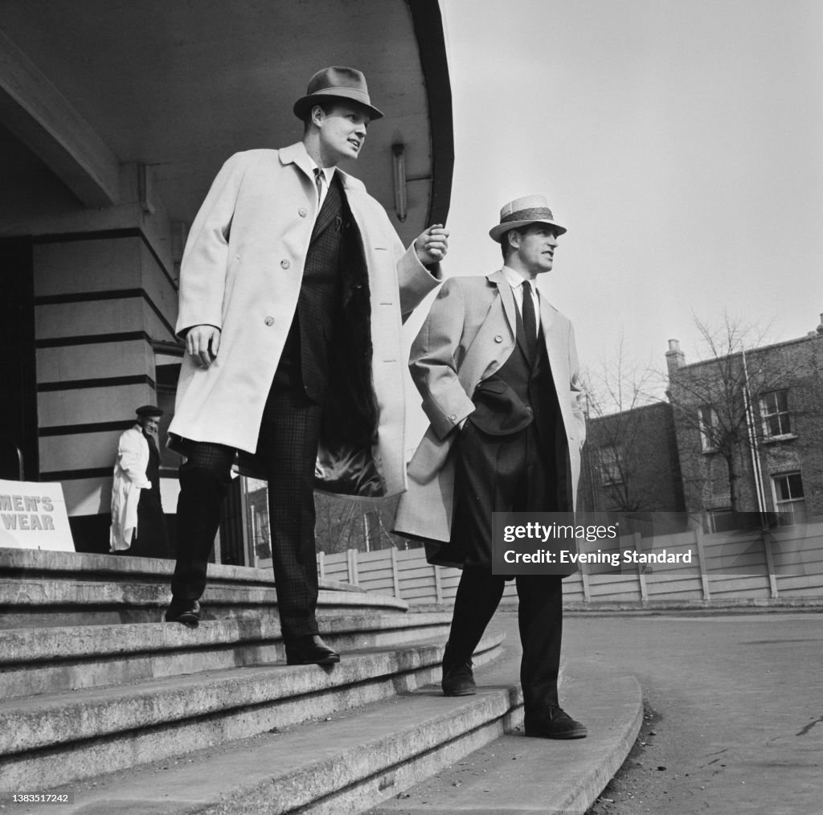
The business look 1960

Slide 18
Teen agers 1960

Slide 19
US teenagers 1962…”wholesome” and well dressed

Slide 20
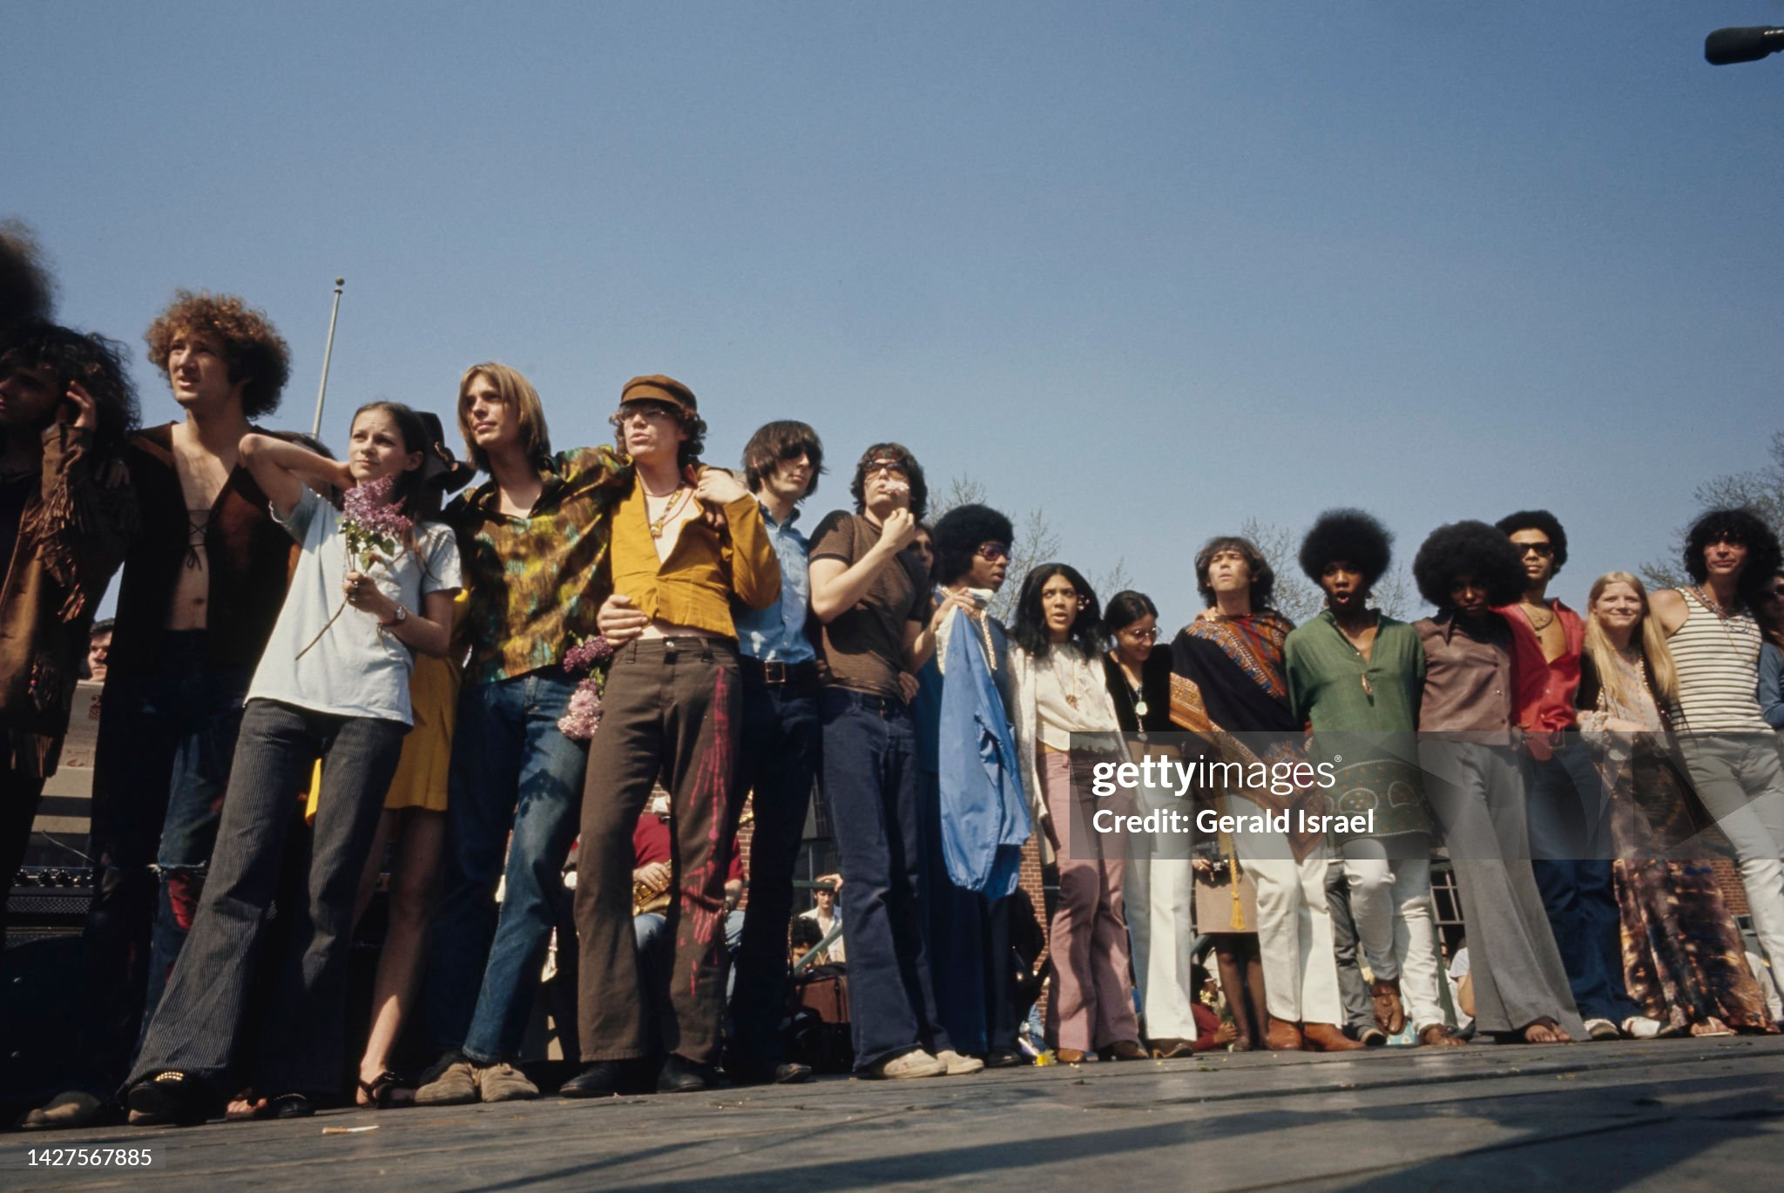
Waiting to attend concert 1968…different time

Slide 21
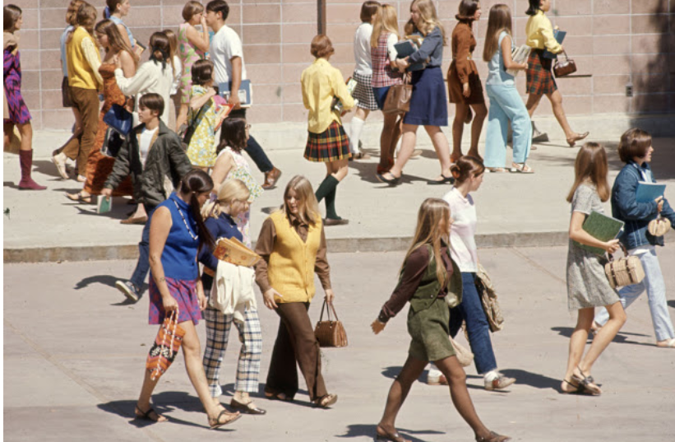
Teenagers us high school 1969

Slide 22
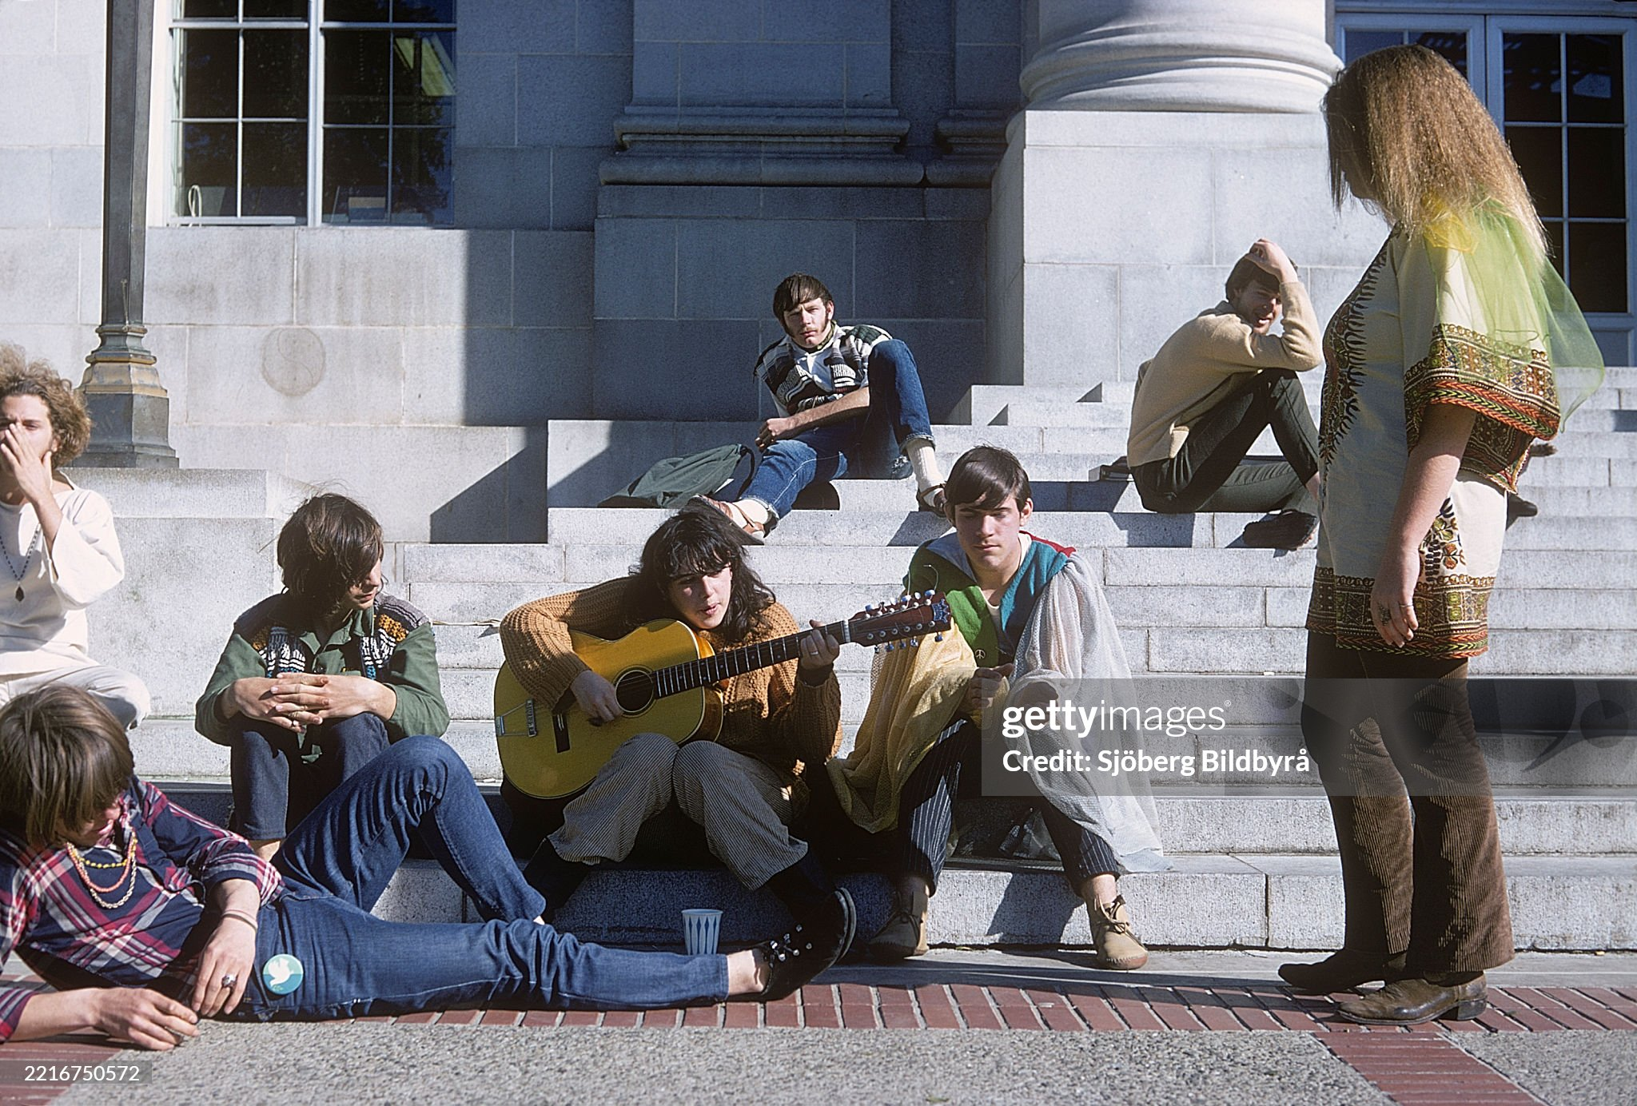
Students University of California Berkley 1968

Slide 23
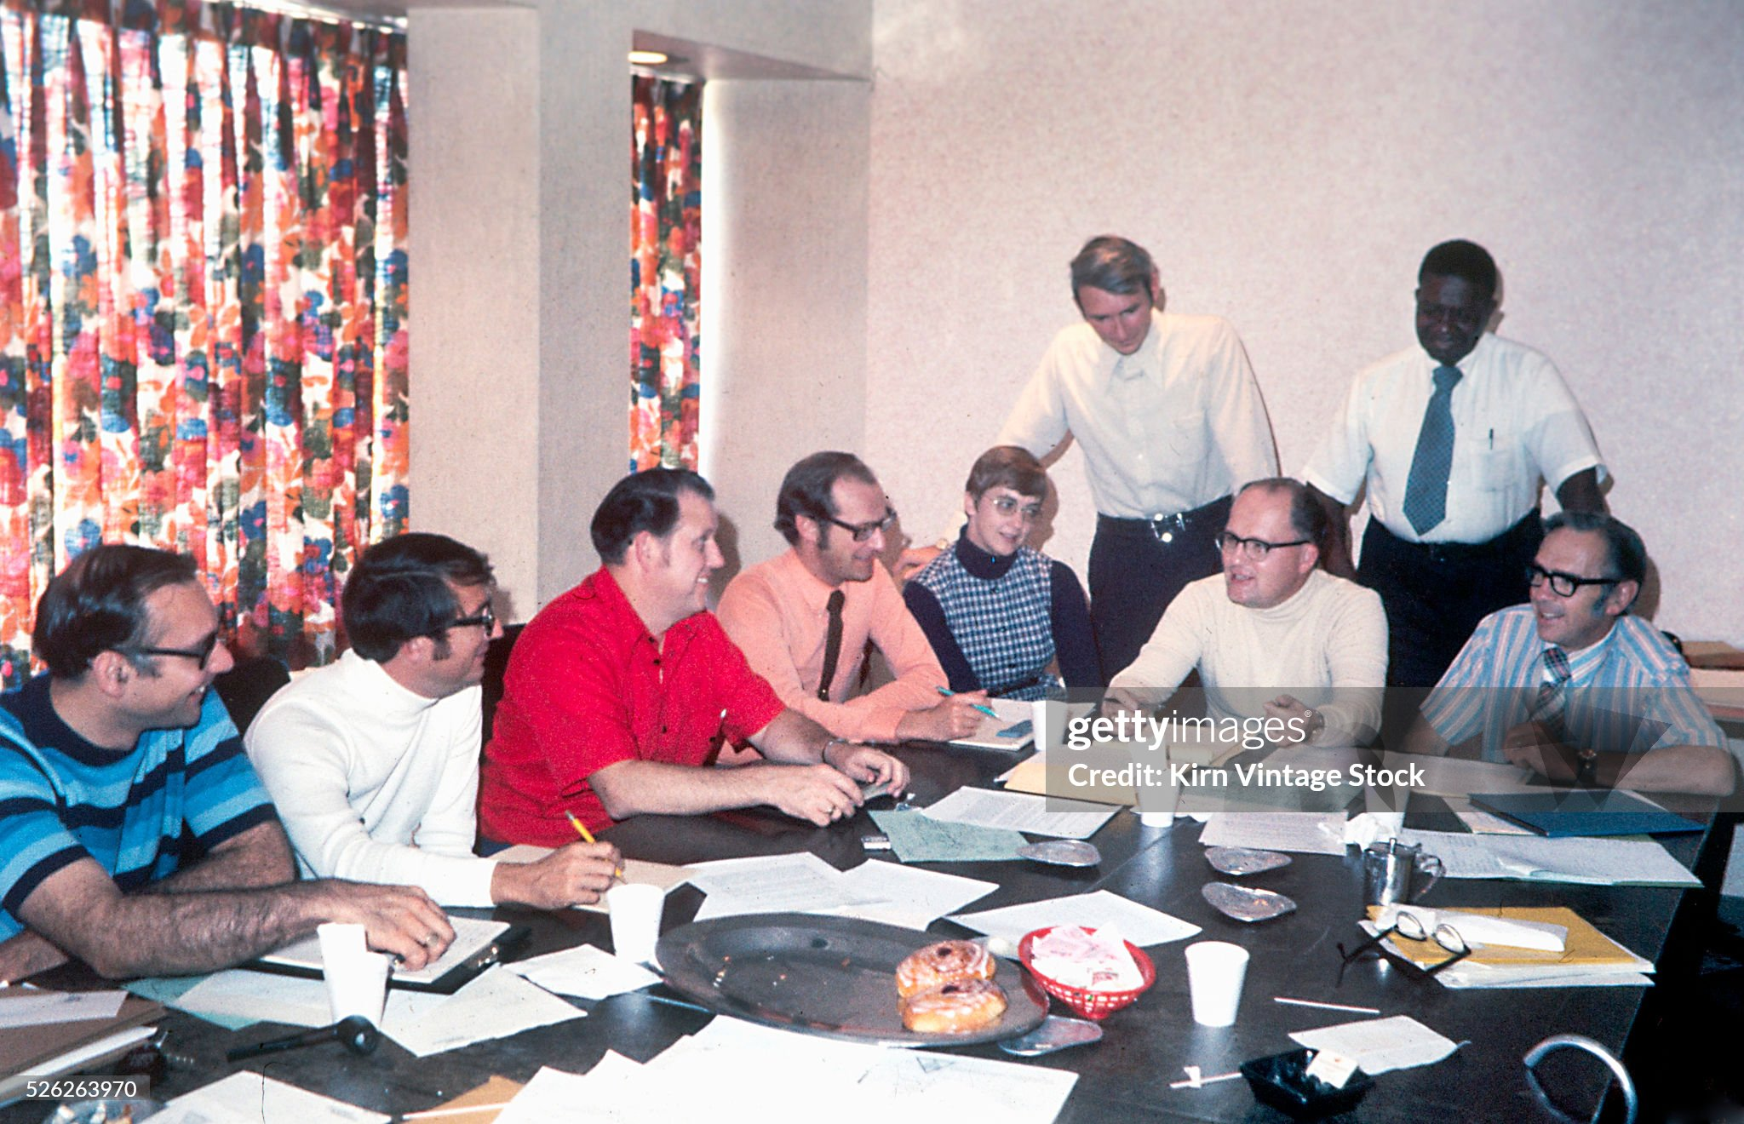
Business meeting 1969…Cleveland Ohio ….less formal with minorities and women present

Slide 24
Happy shoppers 1969

Slide 25
Cars

Slide 26
Golden Age US Car Industry
William Reuther (1907-1970)
Born to Socialist parents
…worked in Ford USA/ sent to USSR Ford
…fired by Ford for Socialism
…Leads strike…Leads Auto Unions WW2
Elected President of US Auto Union 1956
….making auto worker middle class
….no strike deals/benefits
… expels communists/gangsters
….”pattern bargaining”…by company
Social activists. Pro Civil Rights/ MLK support
US auto workers best paid US/world ($70k)
….non compete big car companies
….big uneconomic cars
….foreign competition unnoticed
Survives 2 assassination attempts
Killed in plane crash 1970…suspicious

Slide 27
Automobile Industry 1960’s
Golden years of the automobile industry
Move from “full size” to medium No fins, more boxy look
Fuel economy no concern at $08 per litre 1970….£0.05 !... 13 miles per gallon
Focus on appearance, emission controls, increasing safety
Sales volume increases from 6million per year to 10 million…two car family,
Everyone a winner: Ford, General Motors, Chrysler…imports rising
Competition based on appearance more than performance
High wages, easy finance, profitable companies.
Expanding supply chain….auto dealerships, repair shops, etc
Imports: (Volkswagen Beetle, Toyota Corolla at 10% market and rising
…but not seen as threat…..

Slide 28
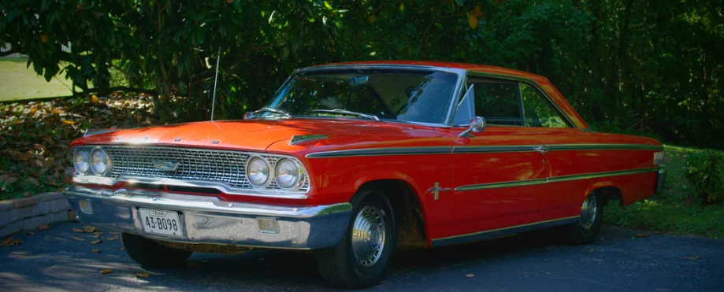
1963 Ford Galaxy

Slide 29
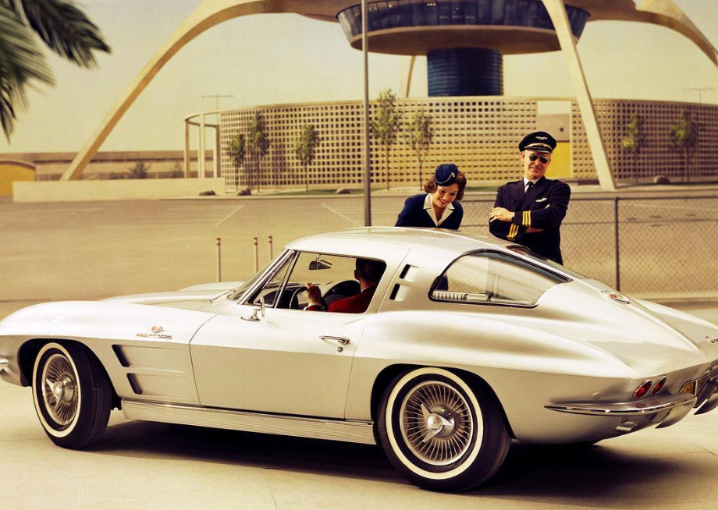
1963 Chevrolet Stingray

Slide 30
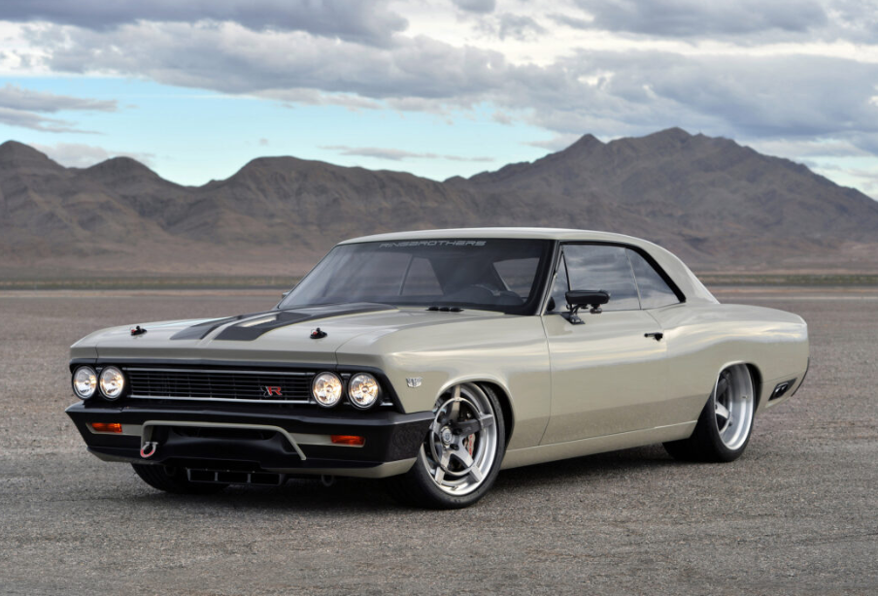
1965 Chevrolet Chevelle

Slide 31
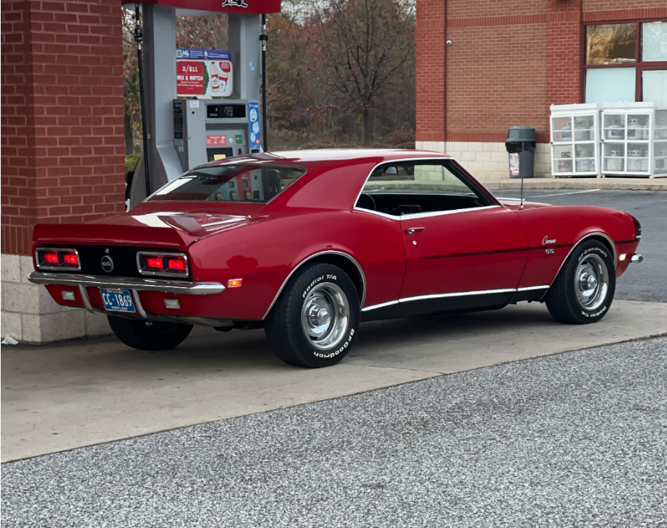
1968 Chevrolet Impala

Slide 32
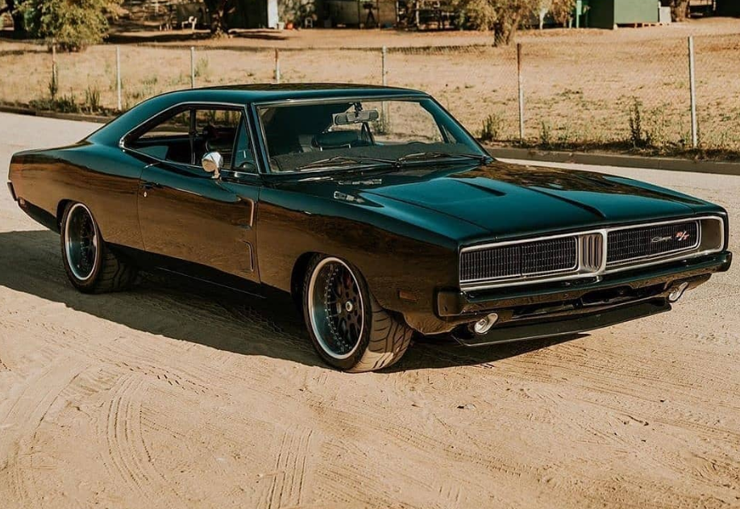
1969 Dodge Charger

Slide 33
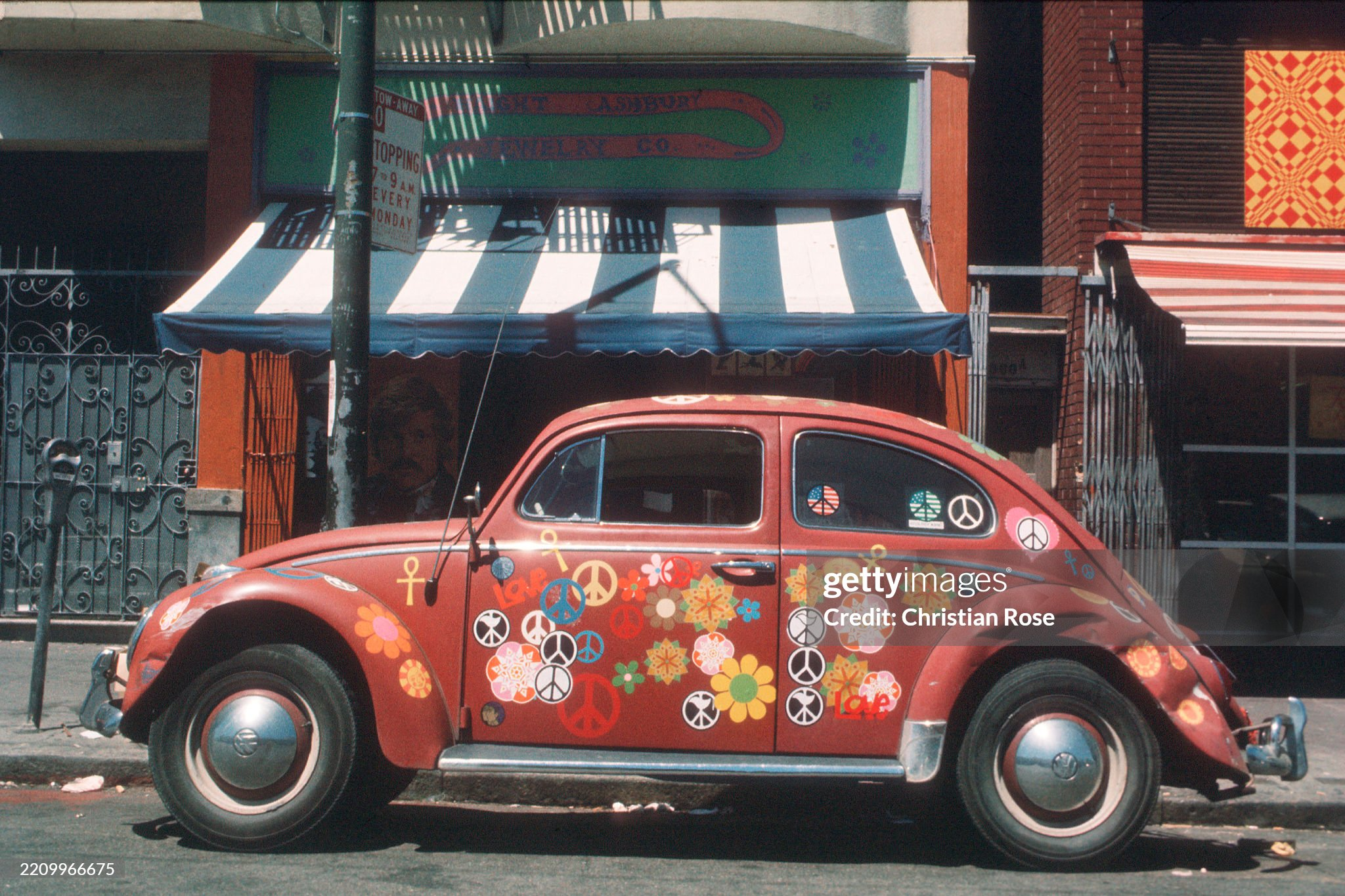
Volkswagen Beetle 1970 San Francisco

Slide 34
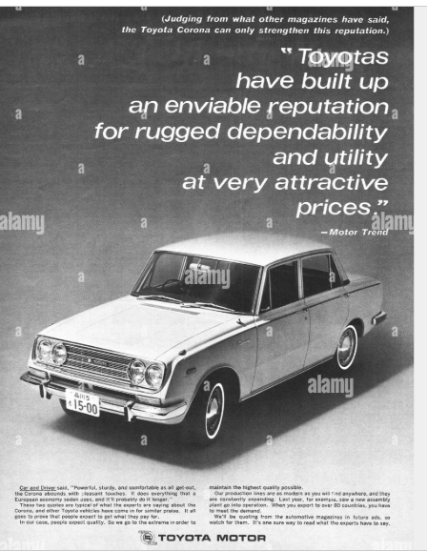
Shape of things to come ….first Toyota Corolla's….introduced 1965

